Slide 1

CAV platoon FDI Attack implementation Platform
Derek Duan,
Tashfique
Department of Electrical and Computer Engineering
University of Florida, Gainesville

Slide 2
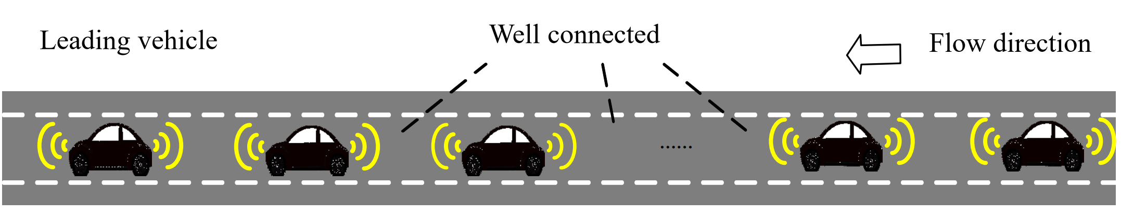
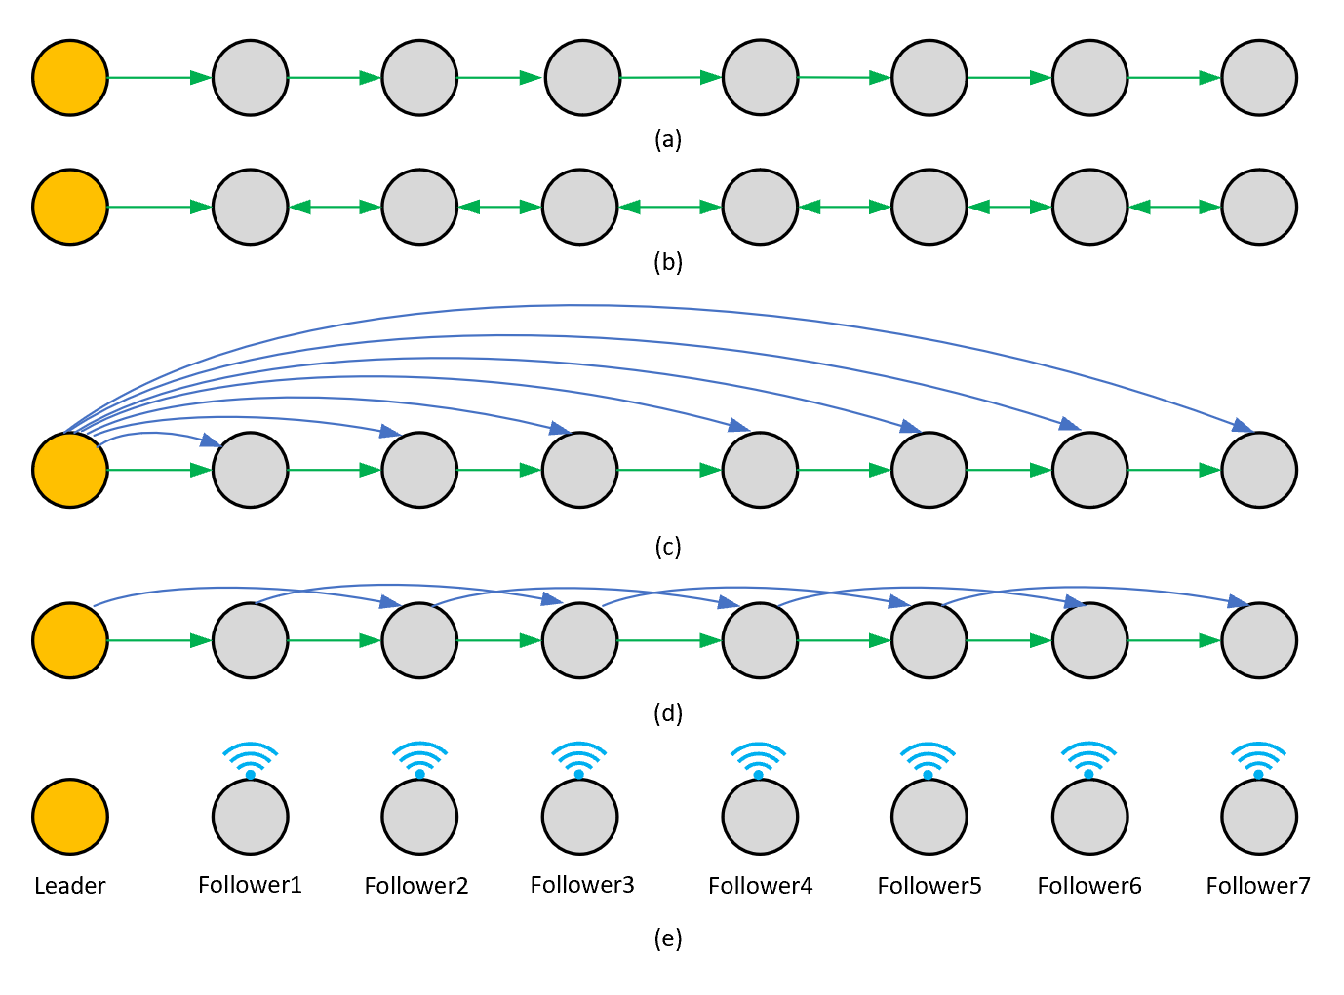
What is a CAV platoon
A group of connected and autonomous vehicles which forms a one-line fleet and following one after another.
The platoon structure can increase the capacity of the road and fuel economy.
Different CAV platoon have its own communication/information topology.
The information shared in the communication channels are mostly position, velocity and acceleration.

Slide 3

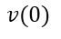
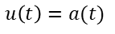
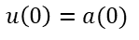
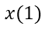
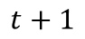
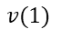
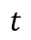
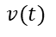
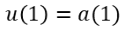
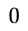
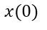
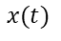
An example of CAV platoon controller
Information from the leader:
e.g. pos_leader(t)
vel_leader(t)
acc_leader(t)
fv_i
Controller
Commanded acceleration value:
fv_i_u(t)
Information from the precedent:
e.g. fv_i-1_pos(t)
fv_i-1_vel(t)
fv_i-1_vel(t)
$$x(t)$$
$$x(0)$$
$$x(1)$$
$$v(t)$$
$$v(0)$$
$$v(1)$$
$$u\left(t\right)=a(t)$$
$$u\left(0\right)=a(0)$$
$$u\left(1\right)=a(1)$$
$$0$$
1
$$t$$
$$t+1$$

Slide 4
Resilient CAV platoon
Since the wireless property of the communication channels, they can be malicious.
We only consider the attacks on the communication channels, and assume that the attacker cannot hack into the hardware or software of the vehicles in the platoon.
Resiliency Wrapper
Resilient platoon controller
Platoon controller

Slide 5
Most research on Resilient CAV platoon
Design a resilient platoon controller
Design/Use a platoon controller
Build attack mechanisms
Build attack mechanisms
Find Resiliency solutions
Generate Results
Generate Results
Why not build a general attack generation platform, so that all researchers in this field can build their attackers based on it, or even can directly use it?

Slide 6
Communication message
Control header
Data Payload
(Based on the communication protocol we use)
(Based on the data we want to transmit. For this research they are mostly pos/vel/acc)
We only consider attacks on the data payload for this research.

Slide 7
Platform Structure
Attack Degree of Freedom
Mode of Corruption
Malicious channel
Attack Frequency Type
Attack Bias Type
Victims
FDI
Index
pos
Continuous
Constant
Replay
Number
vel
Cluster
Linear
DoS
acc
Discrete
Sinusoidal
What to attack
How to attack

Slide 8
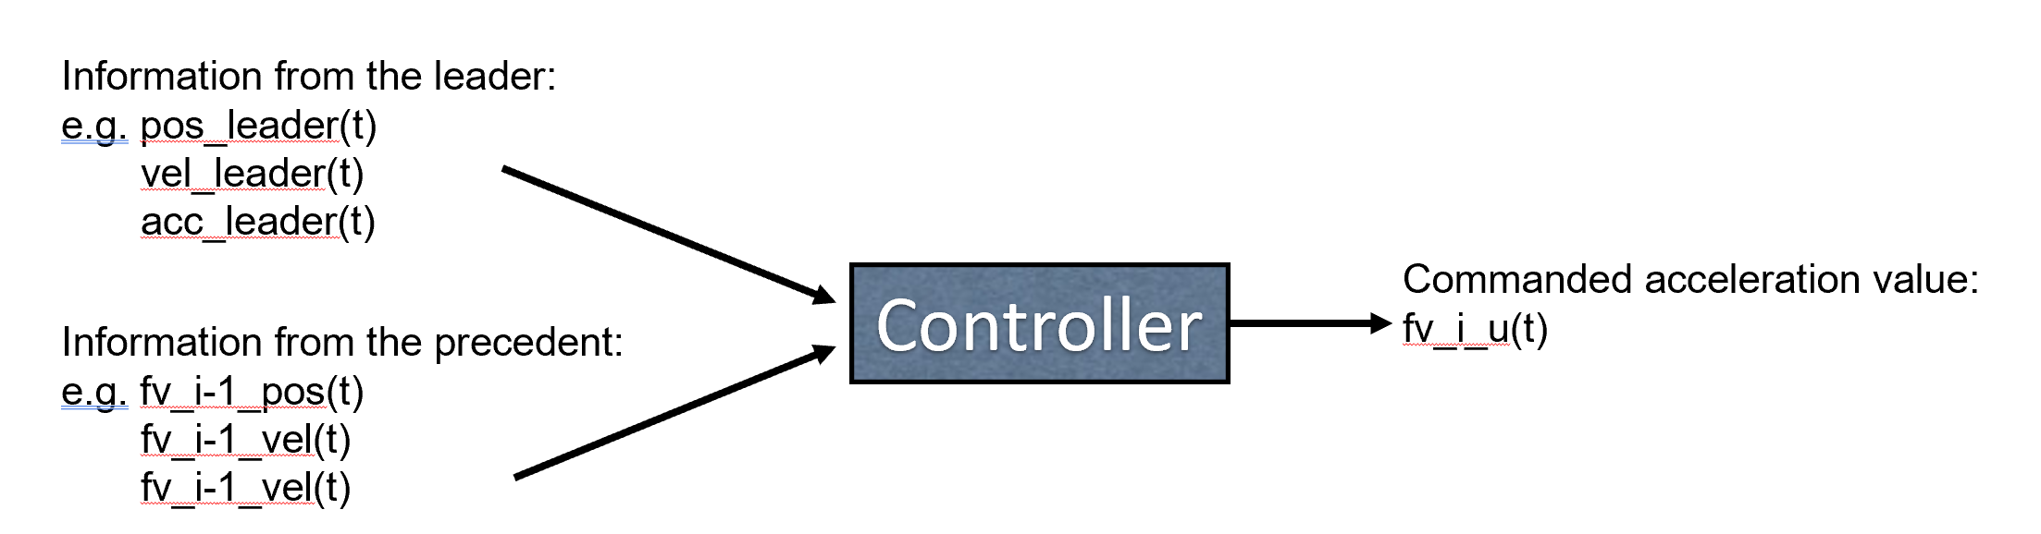
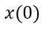
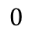
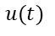
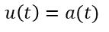
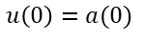
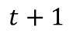
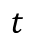
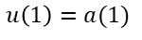
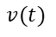
Introduction of a distributed platoon controller
It takes several iterations for a fv to get the final commanded acceleration value for the time t.
Get the other_iteration_position(i-1)s
Calculate its own fv4_iteration position(i)
Check whether the iteration loop end condition is met or not, if not, continue the loop.
abs( other_iteration_position(i-1)s - fv4_iteration position(i) ) < 0.5 or # of loops reaches the defined maximum value
$$x(t)$$
One control step
$$x(0)$$
$$x(1)$$
$$v(t)$$
$$v(0)$$
$$v(1)$$
$$u\left(t\right)=a(t)$$
$$u\left(0\right)=a(0)$$
$$u\left(1\right)=a(1)$$
$$0$$
1
$$t$$
$$t+1$$
One iteration step
$$u(t)$$

Slide 9
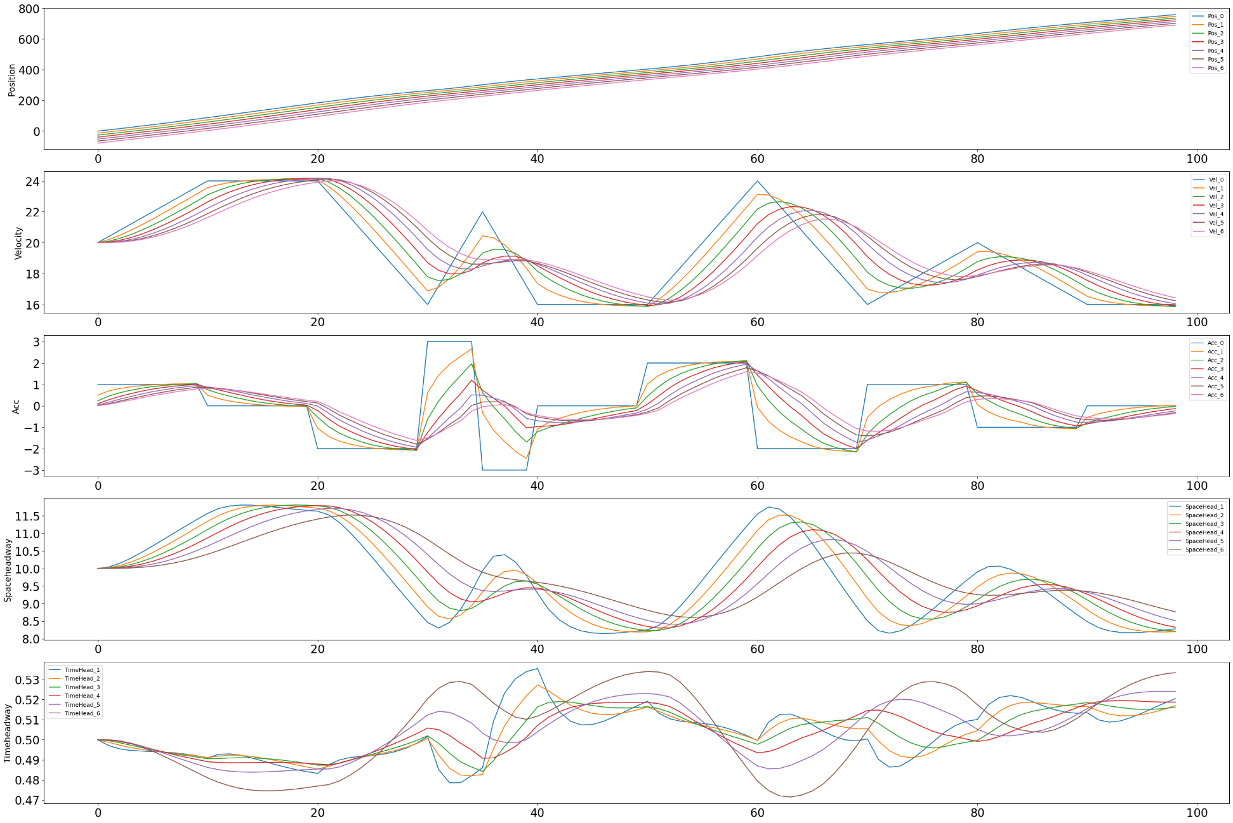
Simulation result under the benign case

Slide 10
Platform Structure
Attack Degree of Freedom
Mode of Corruption
Malicious channel
Attack Frequency Type
Attack Bias Type
Victims
FDI
Index
pos
Continuous
Constant
Replay
Number
vel
Cluster
Linear
DoS
acc
Discrete
Sinusoidal
What to attack
How to attack

Slide 11
Define the Attack DoFs for this controller
Only consider False Data Injection(FDI) for now.
Iter_victim_list
[ 2, 5 ]
control_attackperiod_list
[ [ [10,20], [15,25],…, ], [ [16], [17] ,…, ] ]
[ [ [‘x_ite’], [‘v_ite’],…, ], [ [‘x_ite’,’v_ite’], [‘x_ite’],…,] ]
Iter_malichannel_list
Iter_freqtype_list
[ [ [‘Clus’], [‘Conti’],…,], [ [ ‘Conti’, ’Clus’ ], [‘Conti’],…,] ]
Iter_freqparavalue_list
[ [ [ [4,6] ], [ [2] ],…,], [ [ [3] , [5,5] ], [ [10] ],…,] ]
Iter_biastype_list
[ [ [‘Linear’], [‘Const’],…,], [ [ ‘Sin’, ’Linear’ ], [‘Const’],…,] ]
Iter_biasparavalue_list
[ [ [ [2,5] ], [ [4] ],…,], [ [ [10,2,0,5], [3,4] ], [ [6] ],…,] ]

Slide 12
Generality: Can be implemented in any high-level language
Iter_victim_list
[ 2, 5 ]
loop
control_attackperiod_list
[ [ [10,20], [15,25],…, ], [ [16], [17] ,…, ] ]
branch
[ [ [‘x_ite’], [‘v_ite’],…, ], [ [ ‘x_ite’, ’v_ite’ ], [‘x_ite’],…,] ]
Iter_malichannel_list
Iter_freqtype_list
[ [ [‘Clus’], [‘Conti’],…,], [ [ ‘Conti’, ’Clus’ ], [‘Conti’],…,] ]
branch
Iter_freqparavalue_list
[ [ [ [4,6] ], [ [2] ],…,], [ [ [3] , [5,5] ], [ [10] ],…,] ]
Iter_biastype_list
[ [ [‘Linear’], [‘Const’],…,], [ [ ‘Sin’, ’Linear’ ], [‘Const’],…,] ]
branch
Iter_biasparavalue_list
[ [ [ [2,5] ], [ [4] ],…,], [ [ [10,2,0,5], [3,4] ], [ [6] ],…,] ]

Slide 13
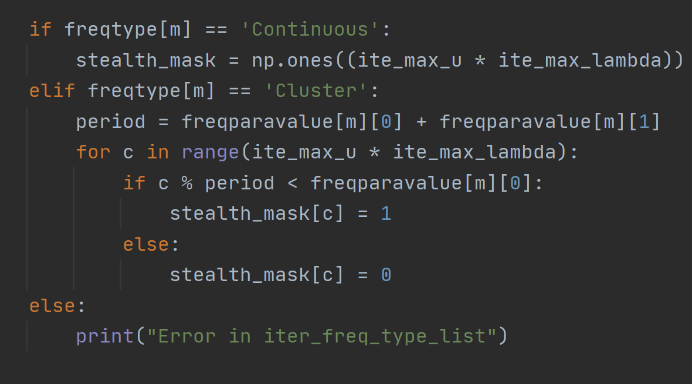
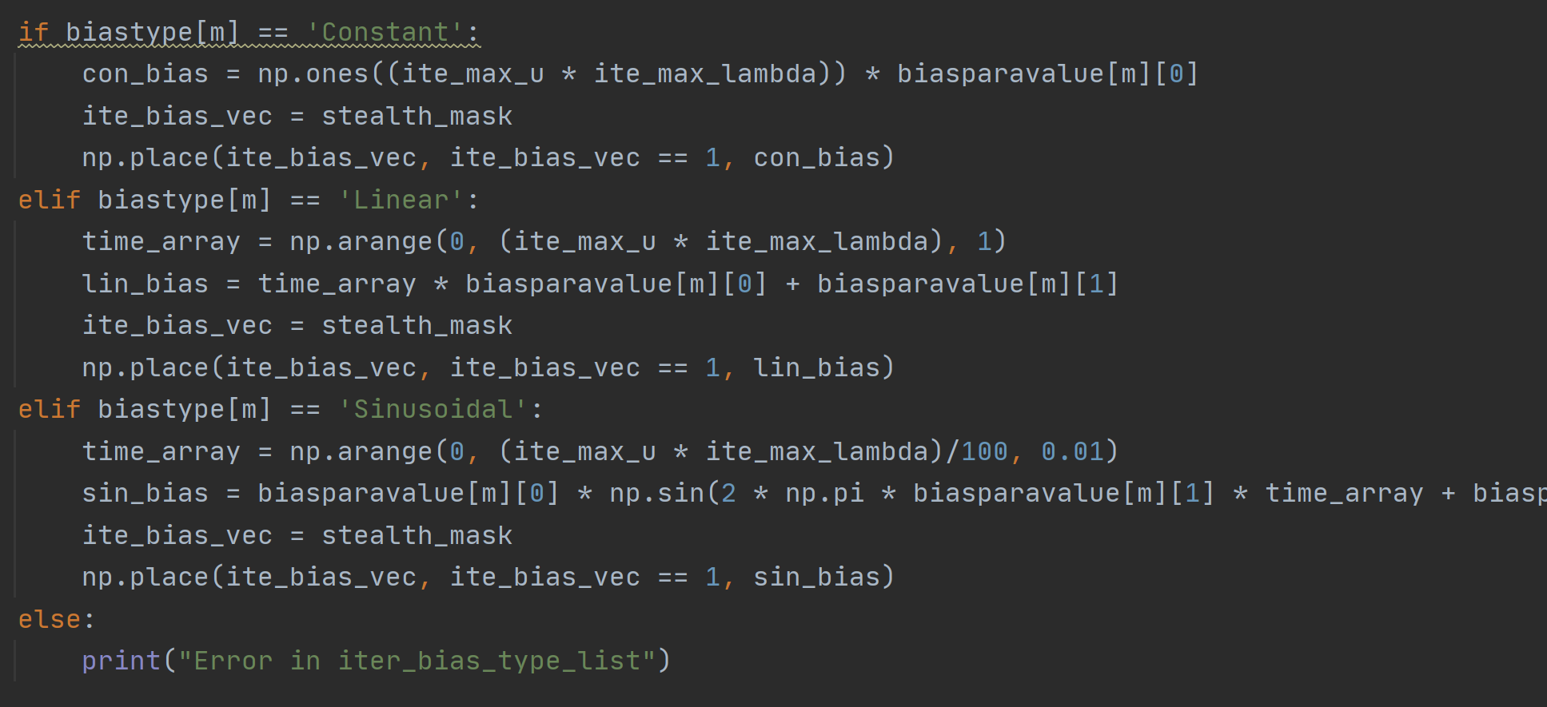
Extensibility: Can add more attack DoF in future
Iter_victim_list
control_attackperiod_list
Iter_malichannel_list
Iter_freqtype_list
Iter_freqparavalue_list
Iter_biastype_list
Iter_biasparavalue_list

Slide 14
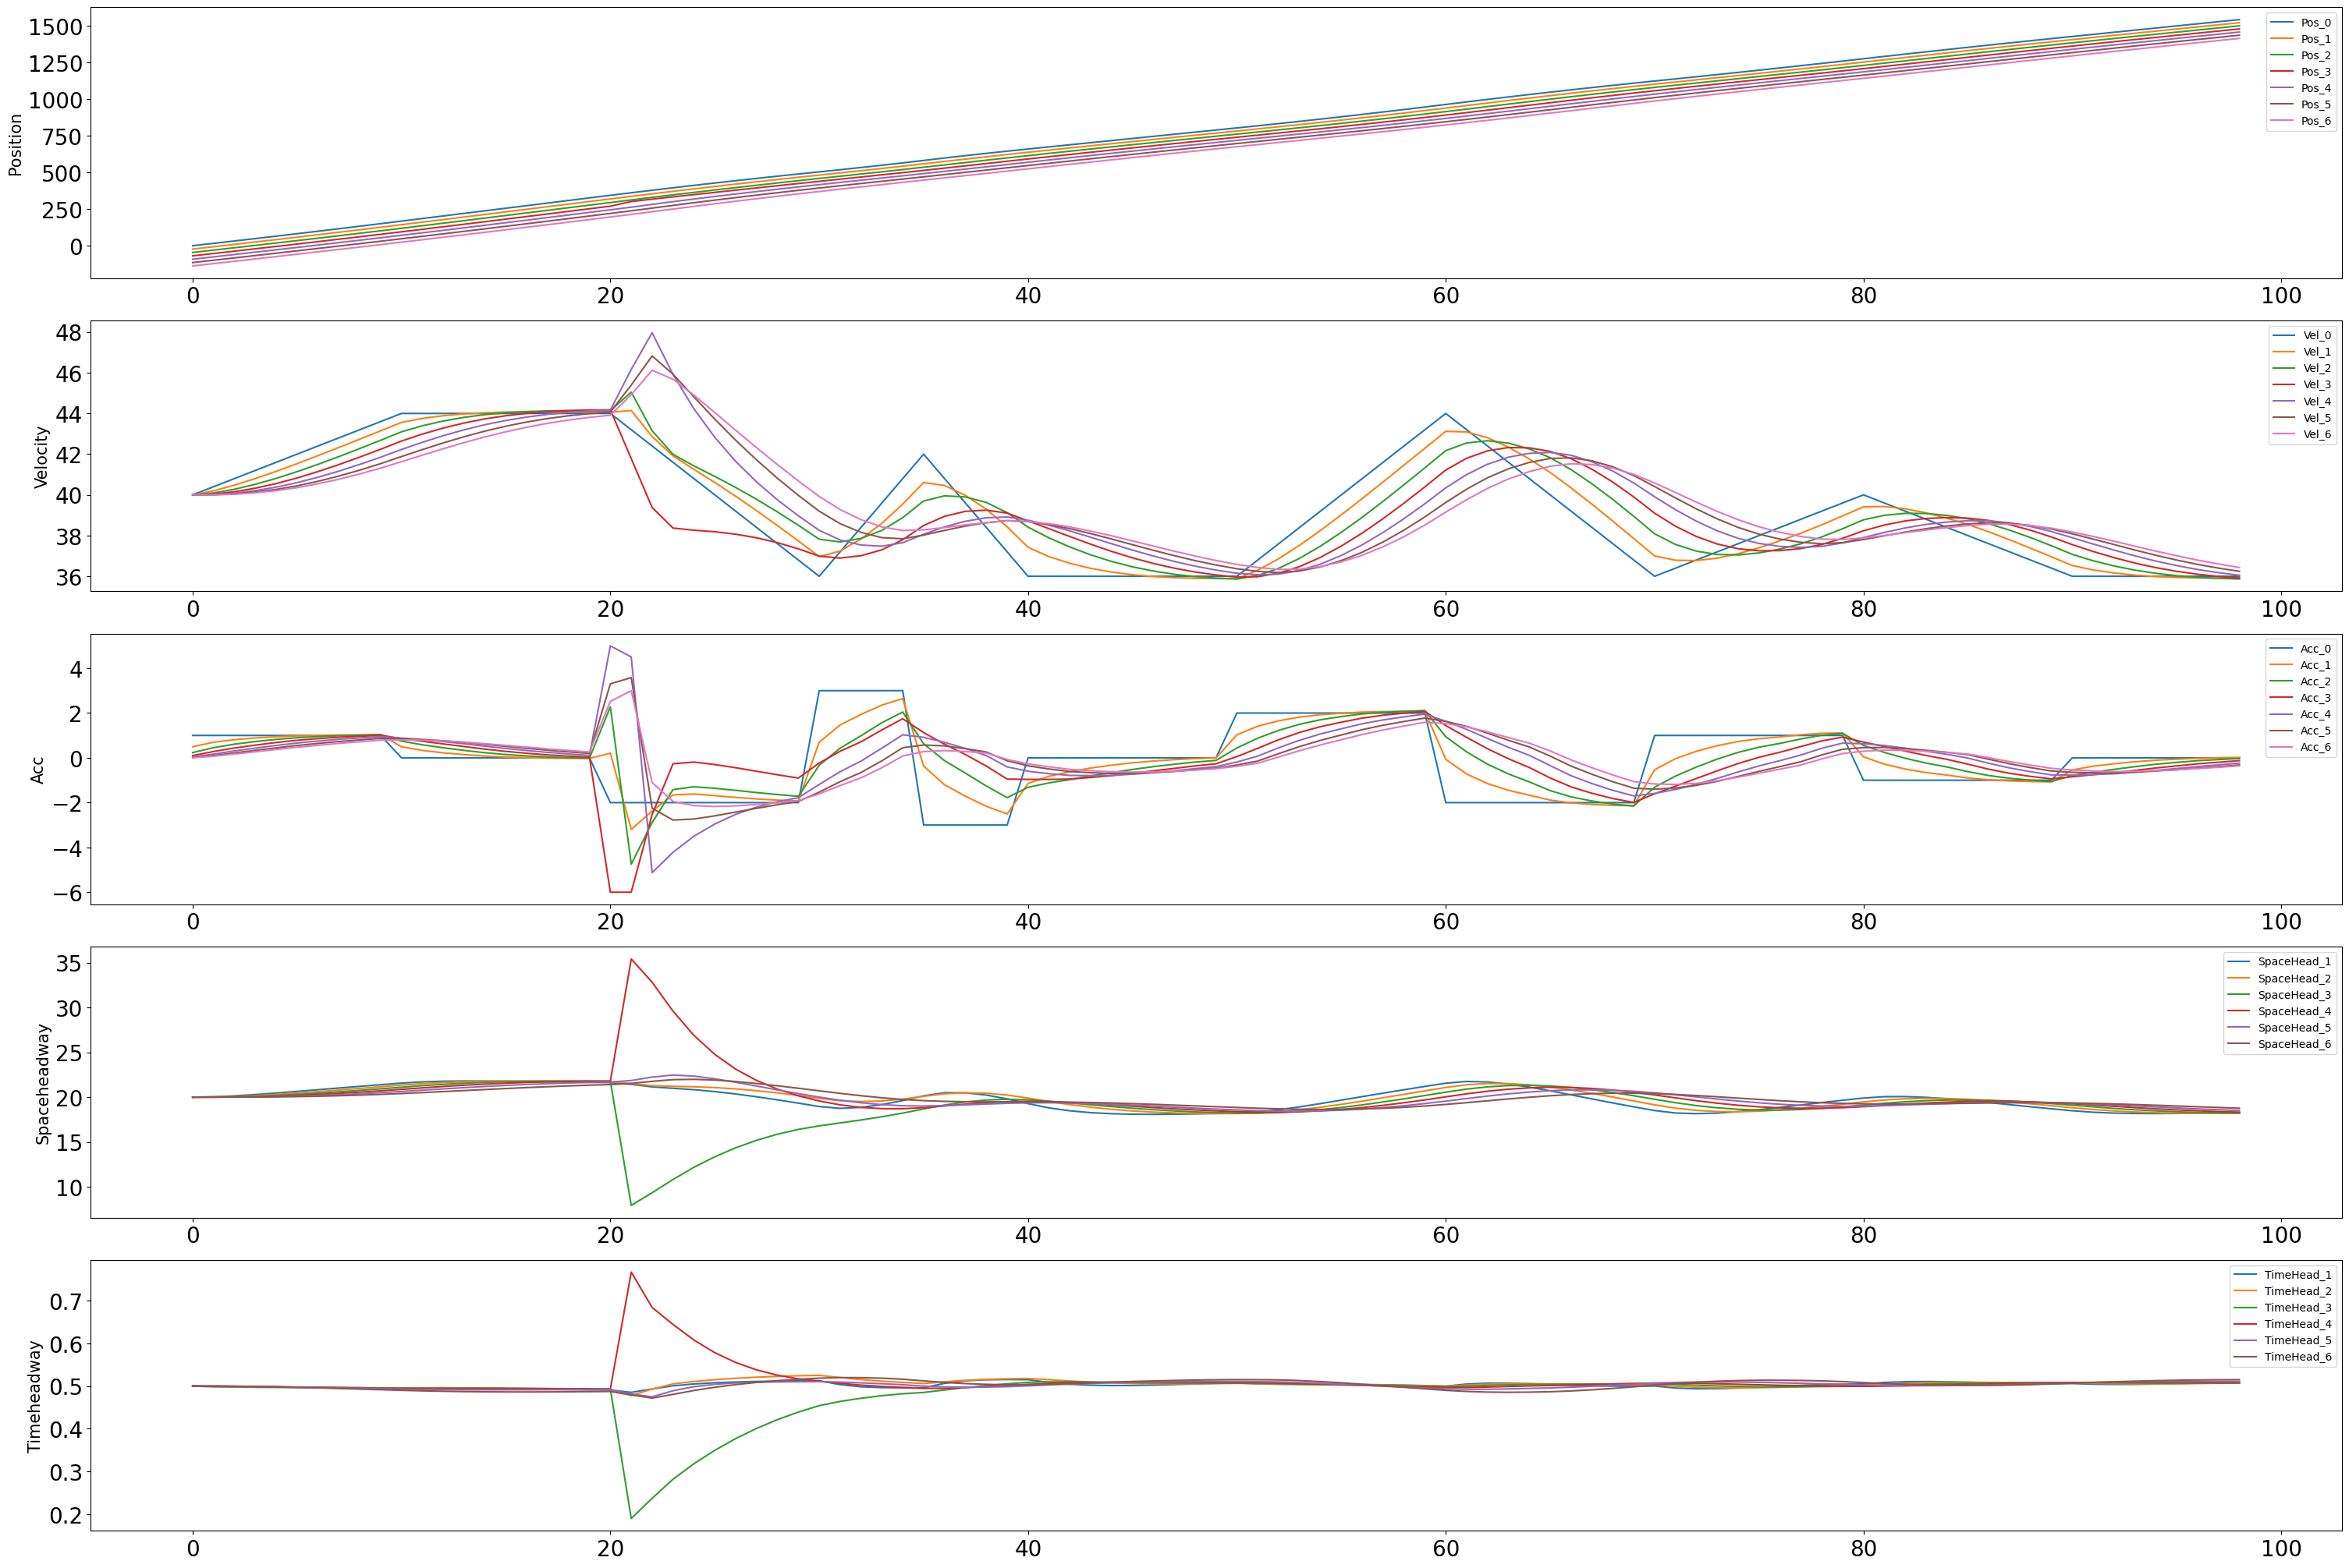
Attack Implementation
1.Attack one victim, one control step, 'x_ite', 'Continuous', 'Constant', [y]
"y" is the biasstart value
Find the smallest bias value 'y' which can have a significant negative impact. (e.g. the victim's timeheadway is more than a half of the safety timeheadway) (e.g. if most of the vehicles' timeheadway is 0.6s, but the victim's is 0.9s, then we will consider it as dangerous) [y = 14.5]

Slide 15
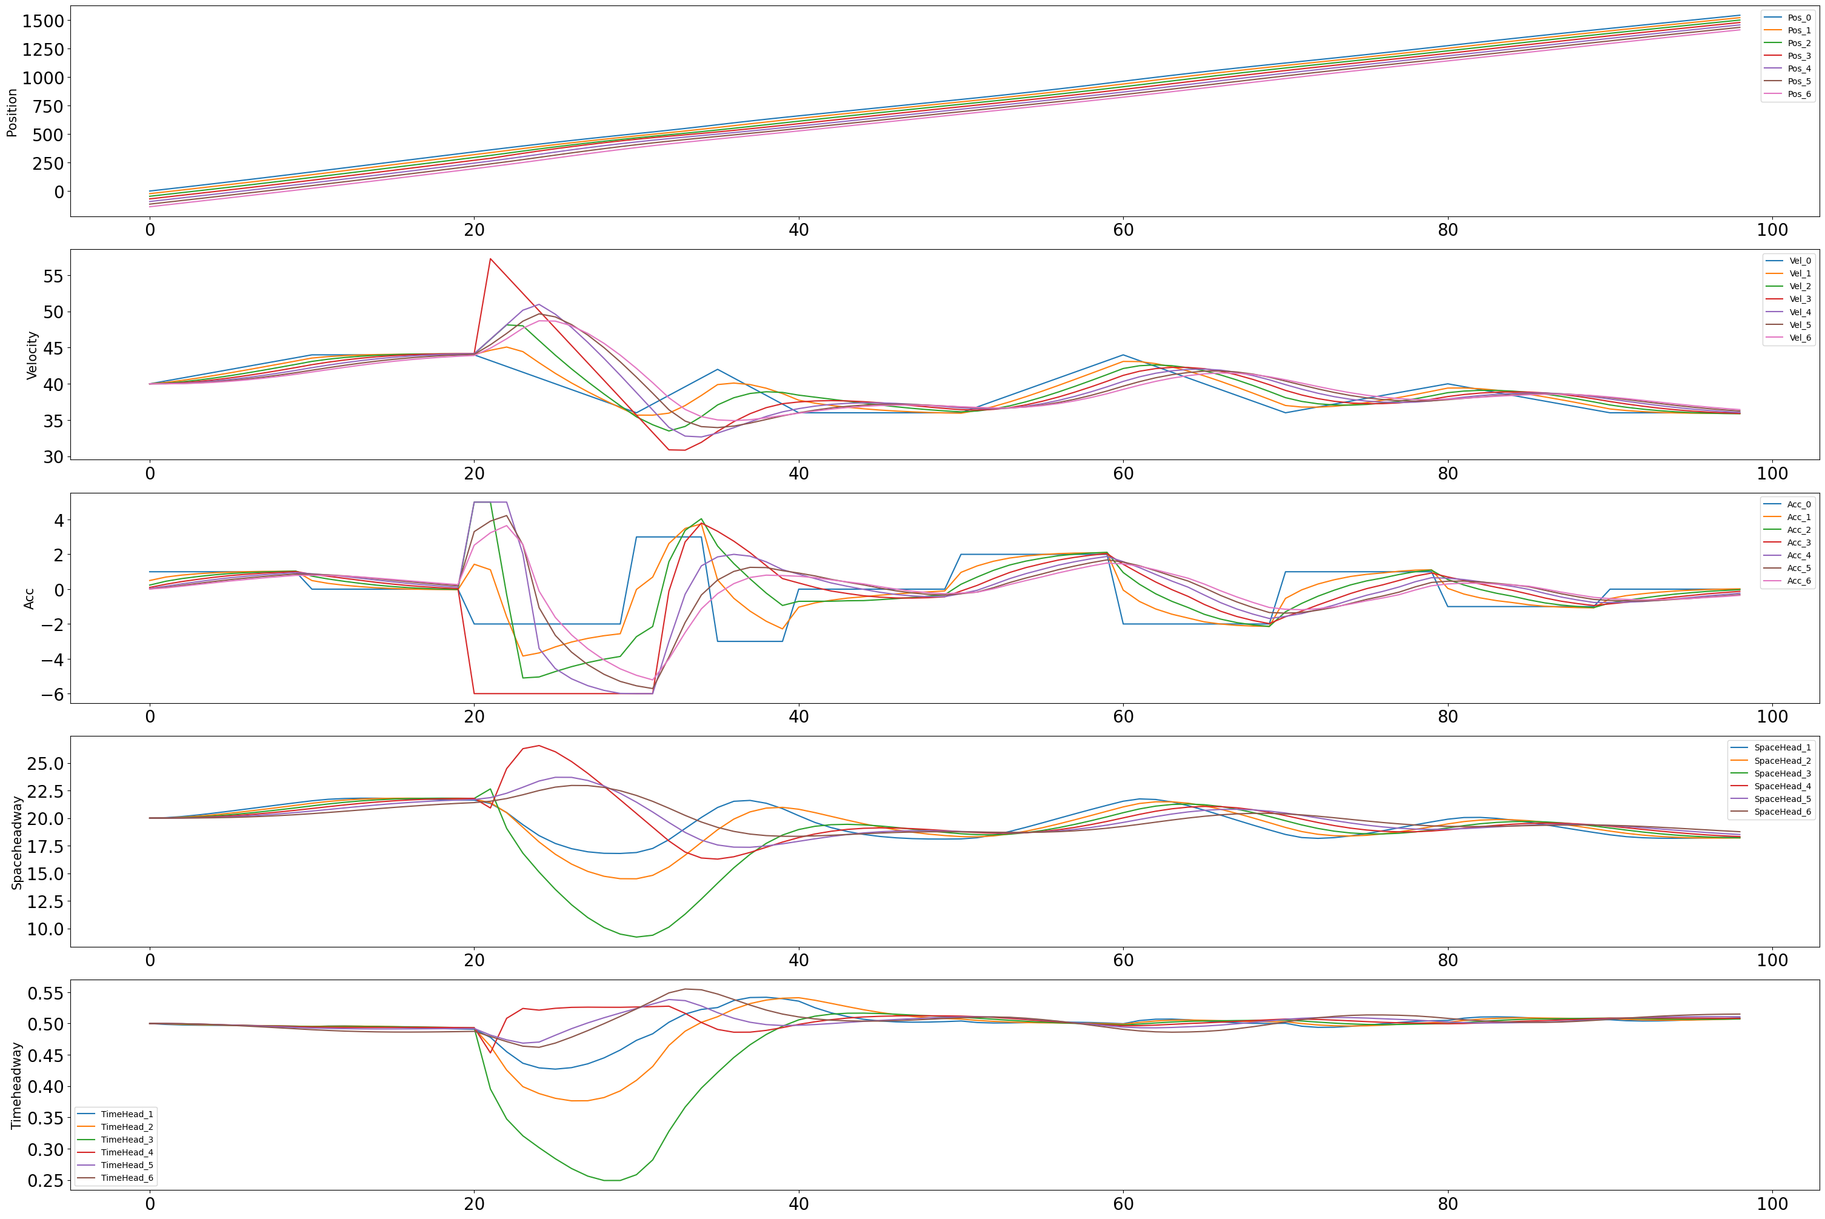
Attack Implementation
2. Attack one victim, one control step, 'v_ite', 'Continuous', 'Constant', [y]
"y" is the biasstart value
Find the smallest bias value 'y' which can have a significant negative impact. (e.g. the victim's timeheadway is more than a half of the safety timeheadway) (e.g. if most of the vehicles' timeheadway is 0.6s, but the victim's is 0.9s, then we will consider it as dangerous) [y = 15.5]

Slide 16
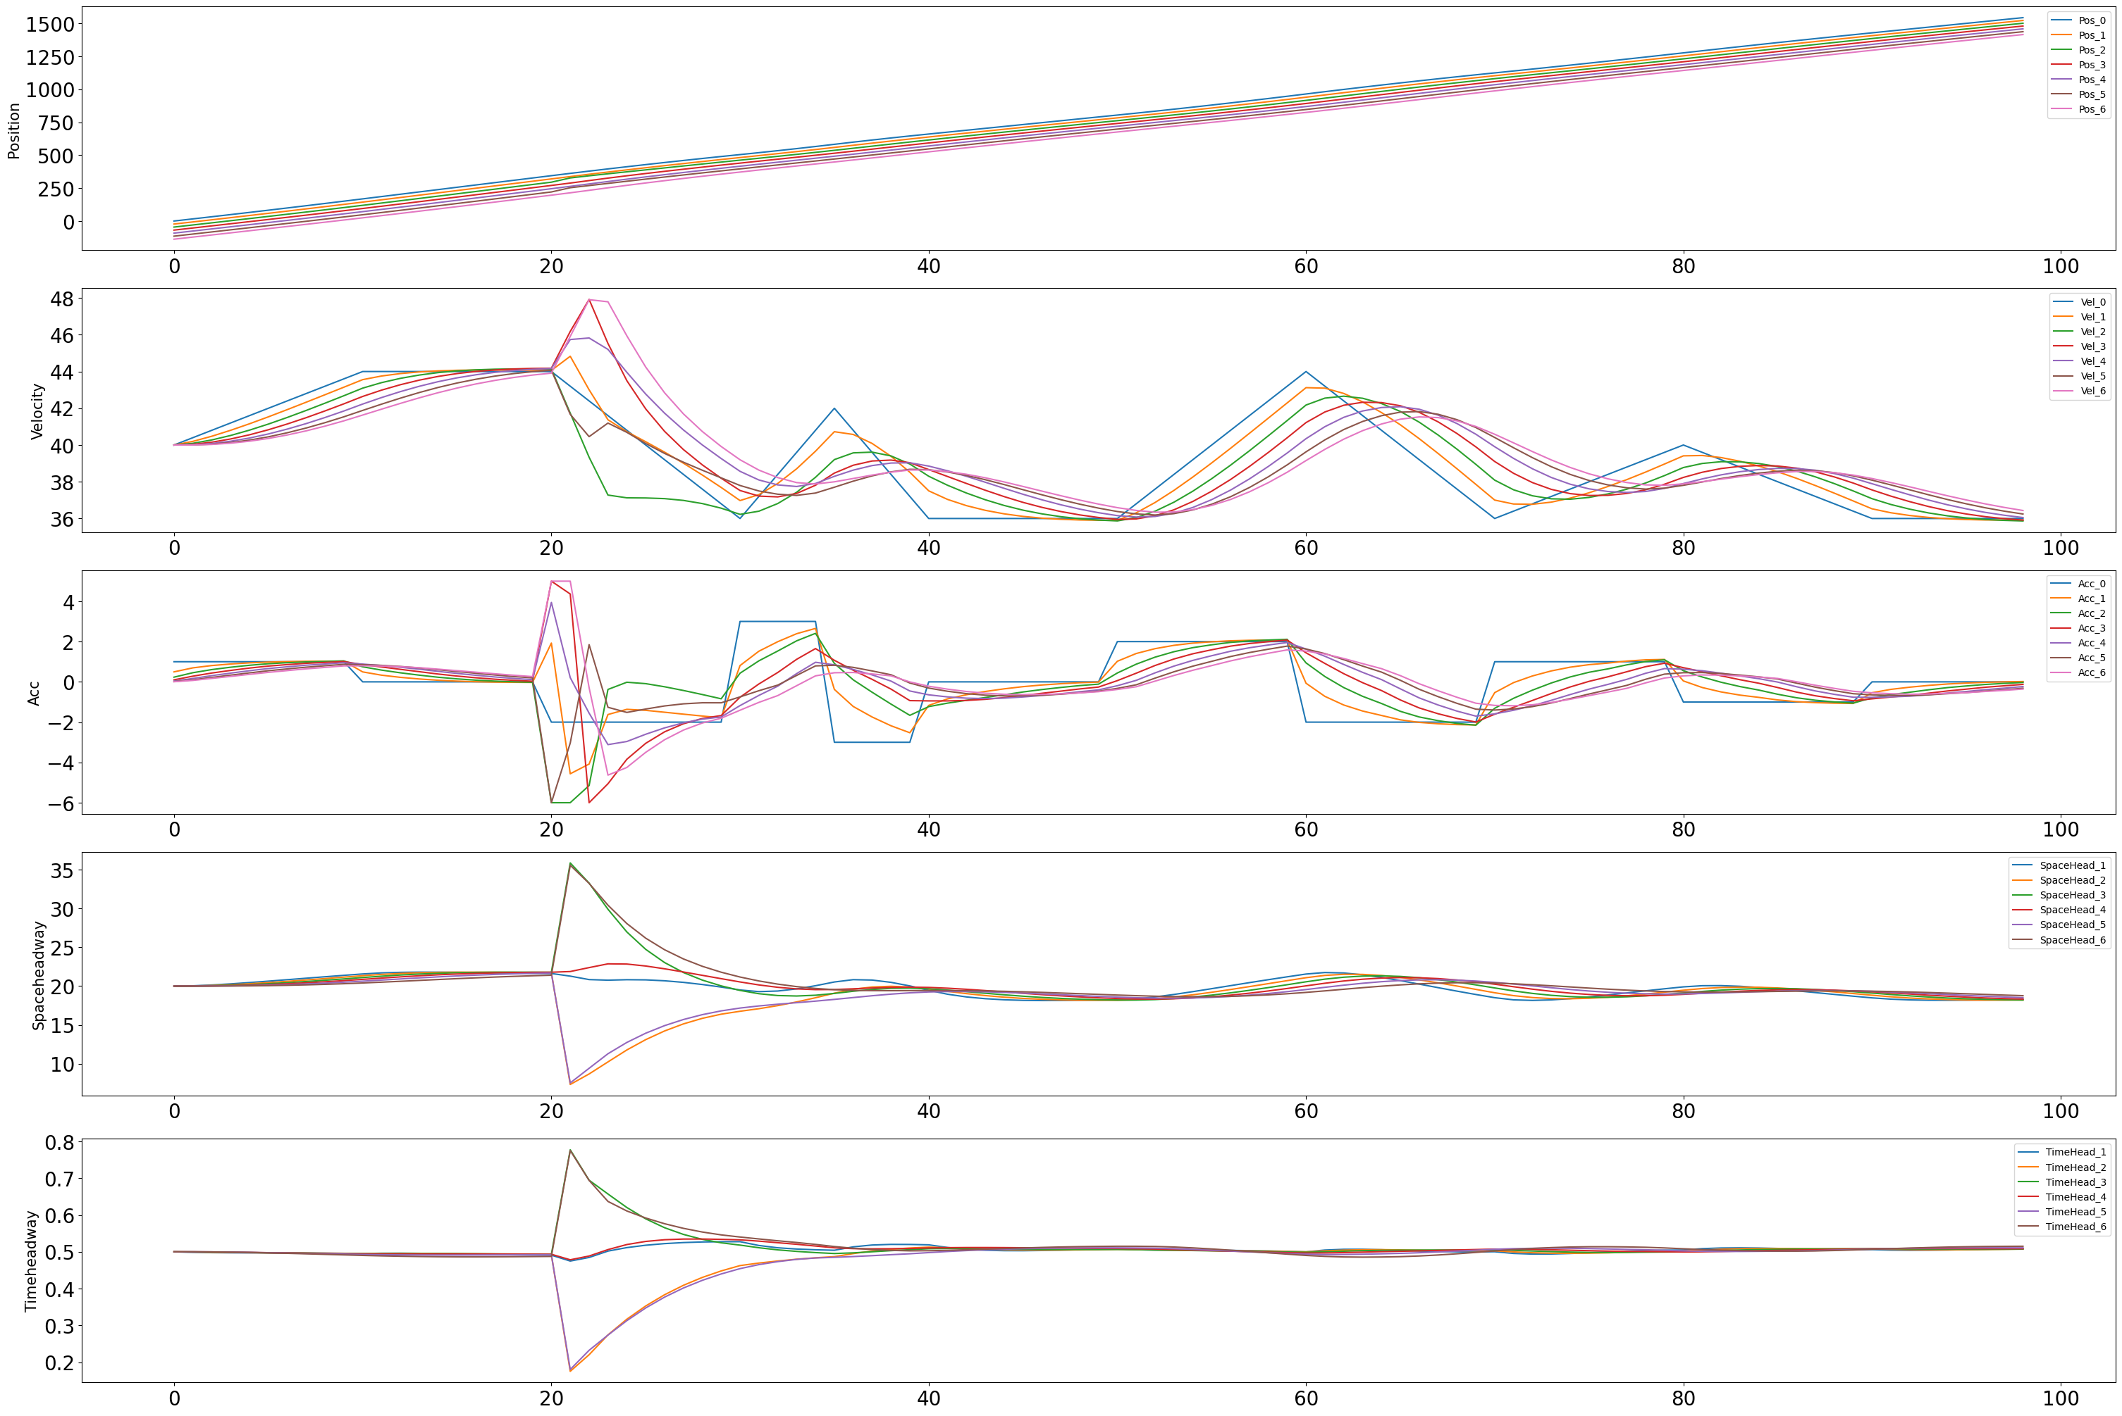
Attack Implementation
3. Attack multi victims in the same one control step, 'x_ite', 'Continuous', 'Constant', [y]
"y" is the biasstart value
Find the smallest bias value 'y' which can have a significant negative impact. (e.g. the victim's timeheadway is more than a half of the safety timeheadway) (e.g. if most of the vehicles' timeheadway is 0.6s, but the victim's is 0.9s, then we will consider it as dangerous) [ y = 14 ]
Victim = [2, 5]

Slide 17
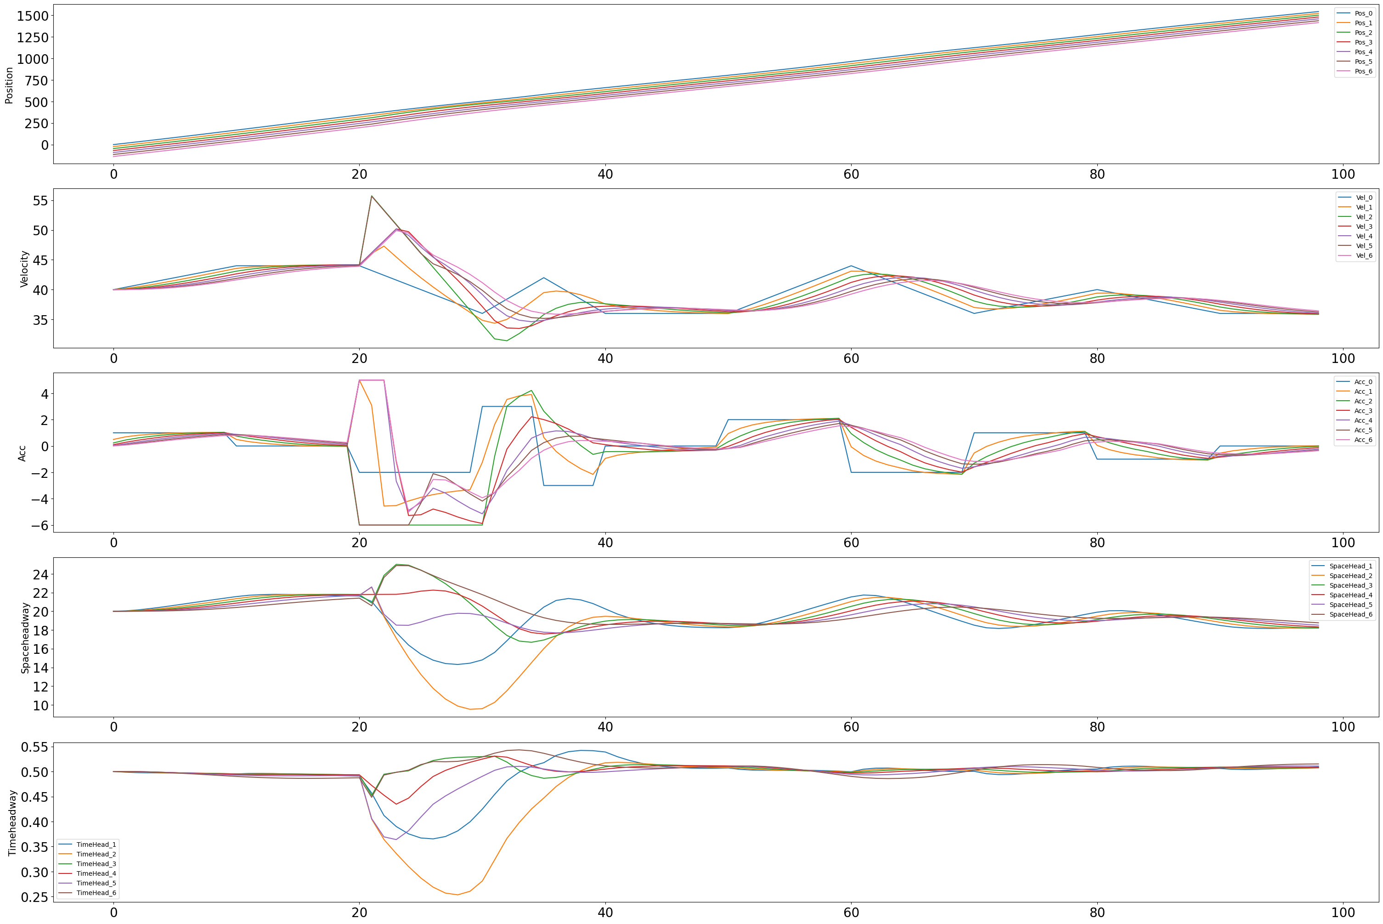
Attack Implementation
4. Attack multi victims in the same one control step, 'v_ite', 'Continuous', 'Constant', [y]
"y" is the biasstart value
Find the smallest bias value 'y' which can have a significant negative impact. (e.g. the victim's timeheadway is more than a half of the safety timeheadway) (e.g. if most of the vehicles' timeheadway is 0.6s, but the victim's is 0.9s, then we will consider it as dangerous) [ y = 14.5 ]
Victim = [2, 5]​

Slide 18
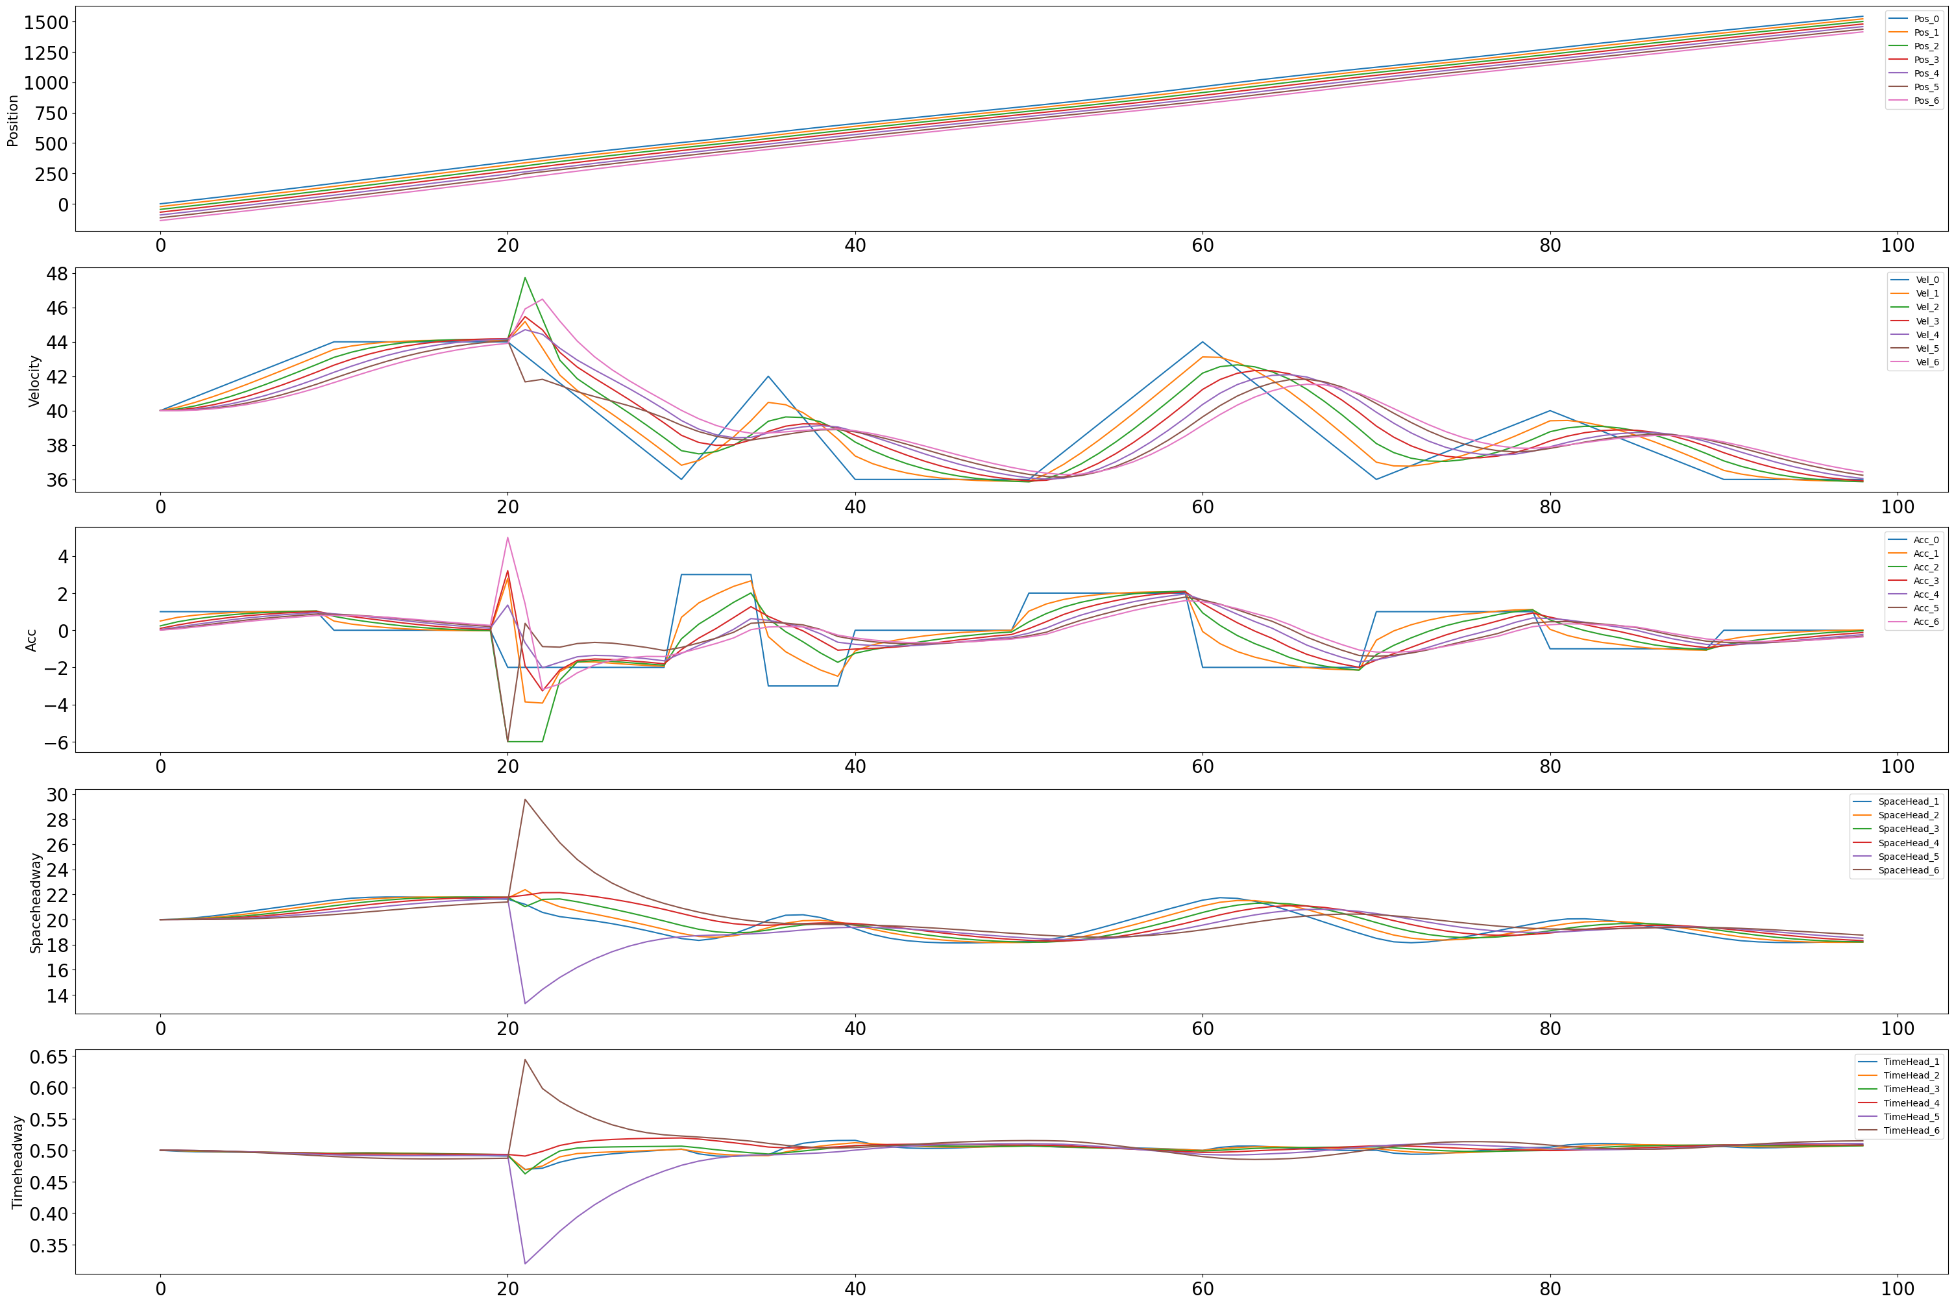
Attack Implementation
5. Attack multi victims in the same one control step, one victim 'v_ite', another victim 'x_ite', 'Continuous', 'Constant', [y], [x]
"x","y" is the biasstart value for position and velocity respectively
Find the smallest bias value 'x', 'y' which can have a significant negative impact. (e.g. the victim's timeheadway is more than a half of the safety timeheadway) (e.g. if most of the vehicles' timeheadway is 0.6s, but the victim's is 0.9s, then we will consider it as dangerous) [ x = 9, y = 6 ]
Victim = [2, 5]​

Slide 19
Attack Implementation
5. Attack one victim, one control step, 'x_ite', 'Cluster', [x, 300], 'Constant', [y]
"x" is the number of the first few iteration steps which is under attacked. "y" is the biasstart value
Find the relation between x and the smallest bias value 'y' which can have a significant negative impact. (e.g. the victim's timeheadway is more than a half of the safety timeheadway) (e.g. if most of the vehicles' timeheadway is 0.6s, but the victim's is 0.9s, then we will consider it as dangerous)
​
X = 18 [Minimum iterations for an impact but doesn’t cross safe thw]​
X = 19, y = 15.5
X = 21, y = 15.5
X = 23, y = 15
X = 25, y = 15
X = 27, y = 14.5​
X > 27, y = 14. 5 [Saturation]​
​

Slide 20
Attack Implementation
6. Attack one victim, one control step, 'v_ite', 'Cluster', [x, 300], 'Constant', [y]
"x" is the number of the first few iteration steps which is under attacked. "y" is the biasstart value
Find the relation between x and the smallest bias value 'y' which can have a significant negative impact. (e.g. the victim's timeheadway is more than a half of the safety timeheadway) (e.g. if most of the vehicles' timeheadway is 0.6s, but the victim's is 0.9s, then we will consider it as dangerous)
X = 20, y = 16.5 [Minimum iterations for an impact]
X = 22, y = 16
X = 24, y = 16
X = 26, y = 15.75
X = 28, y = 15.5
X = 30, y = 15.5
X > 30, y = 15. 5 [Saturation]

Slide 21
Thanks
Q & A

